Slide 1











EPS Comprehensive School Counseling Program Framework
May 10, 2022

Slide 2
EPS Comprehensive School Counseling Program Framework
Where are we?
2022-2023
May 10, 2022

Slide 3

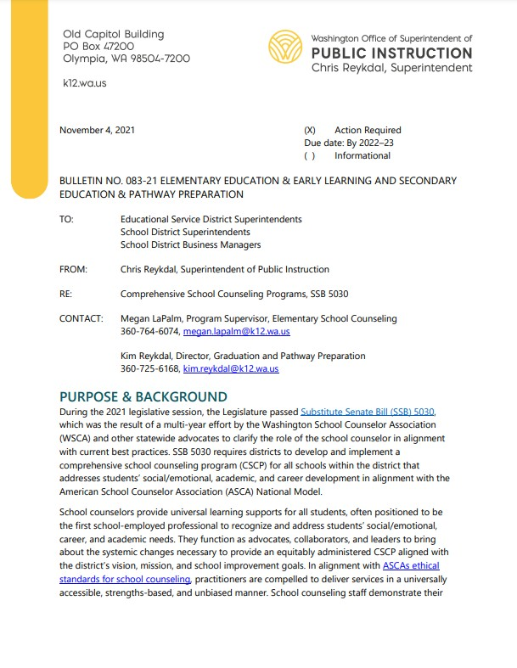
The Context
Substitute Senate Bill 5030
Districts develop a framework for implementing a Comprehensive School Counseling Program (CSCP) for all schools within the district
CSCPs address students’ academic, social/emotional, and career development
CSCPs align with the American School Counselor Association National Model

Slide 4
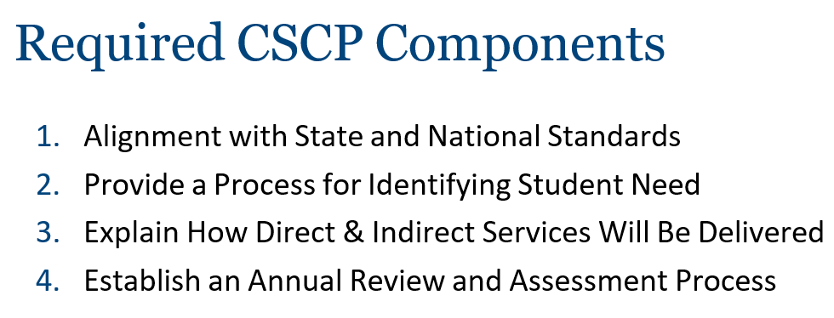
Implementation Details
2022-23 School Year | Begin implementation of district CSCP, utilizing transition plan to work toward full implementation
2023-24 and Beyond | Continue implementation of district CSCP framework and work toward full implementation.

Slide 5
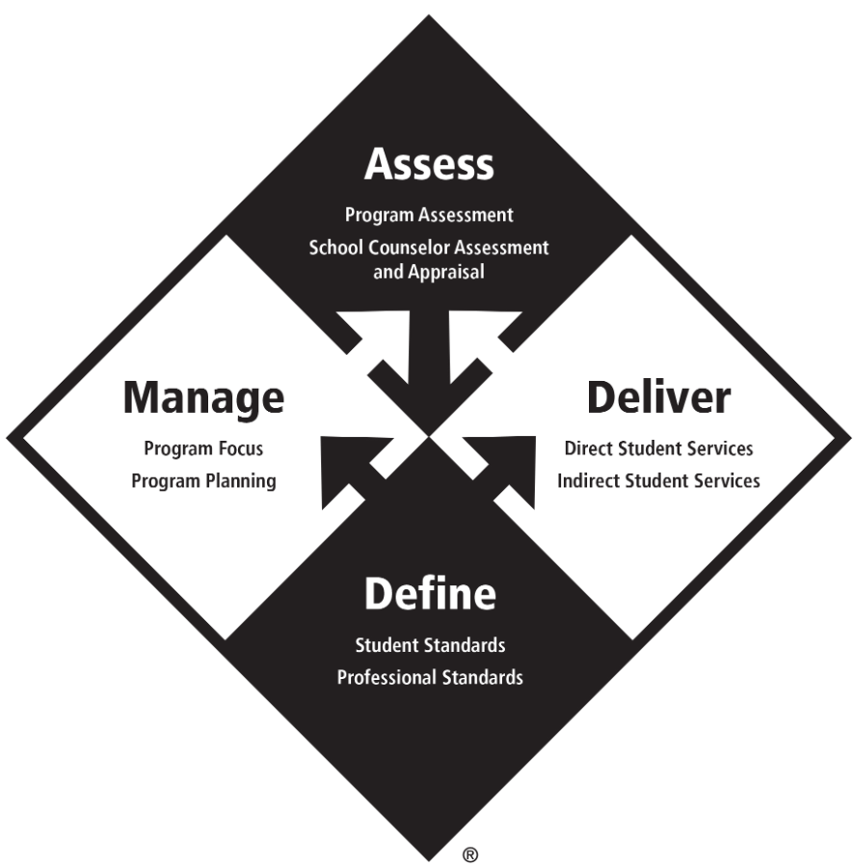
ASCA Model

Slide 6
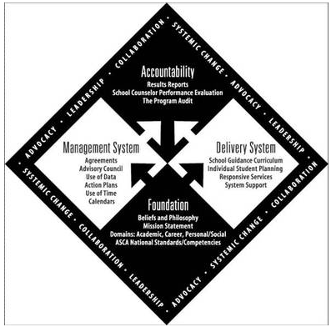
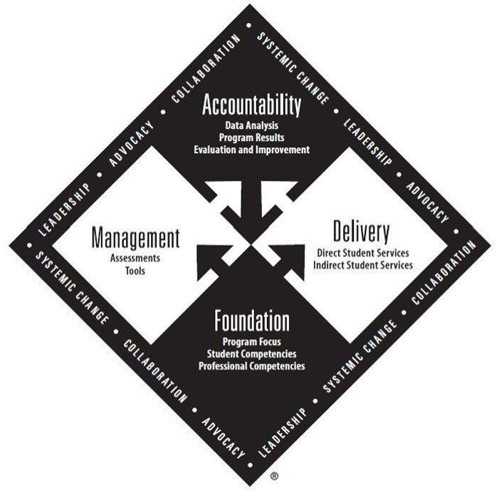
ASCA Through the Models

Slide 7
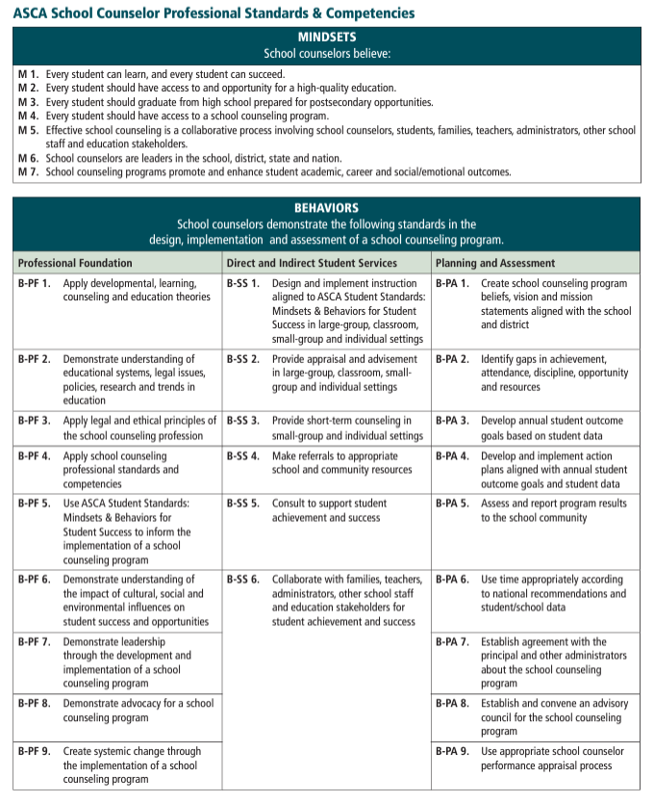
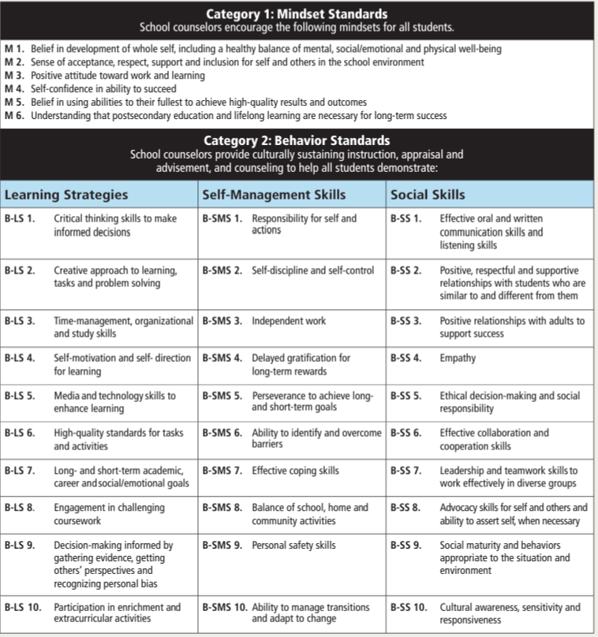
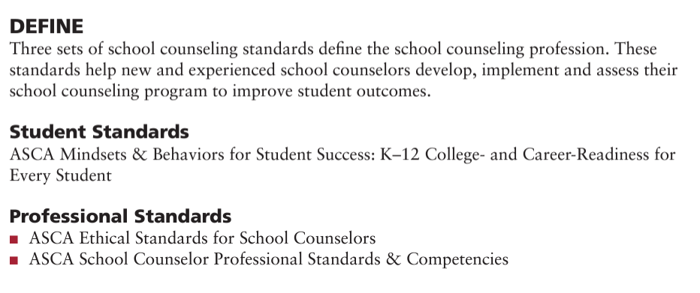

Slide 8
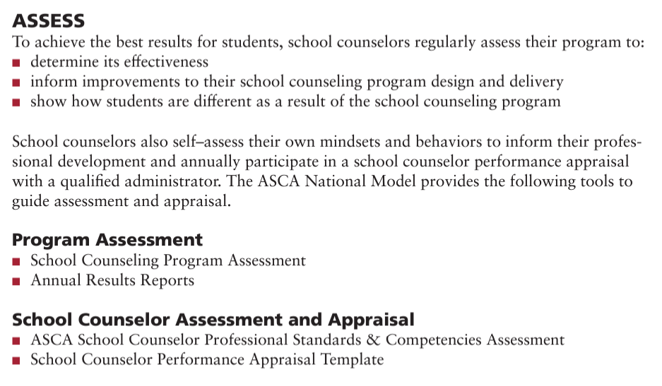
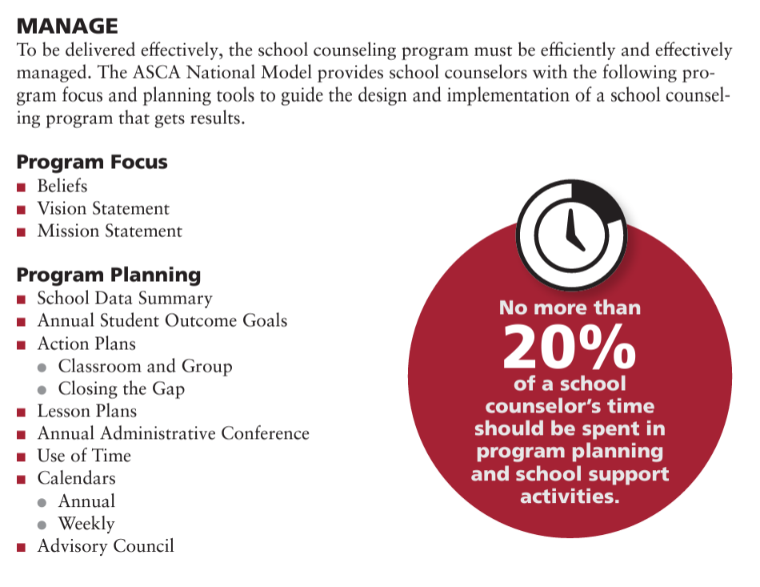
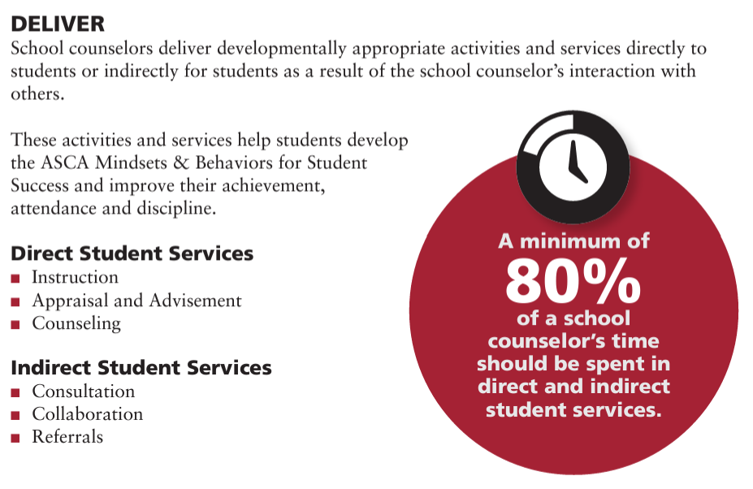

Slide 9
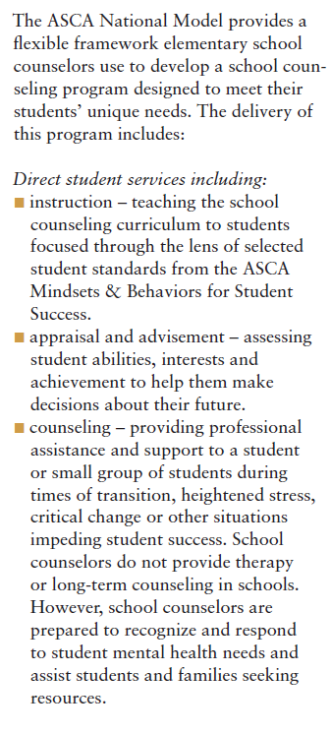

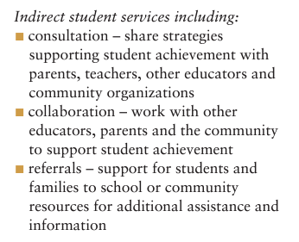
Pg. 80

Slide 10
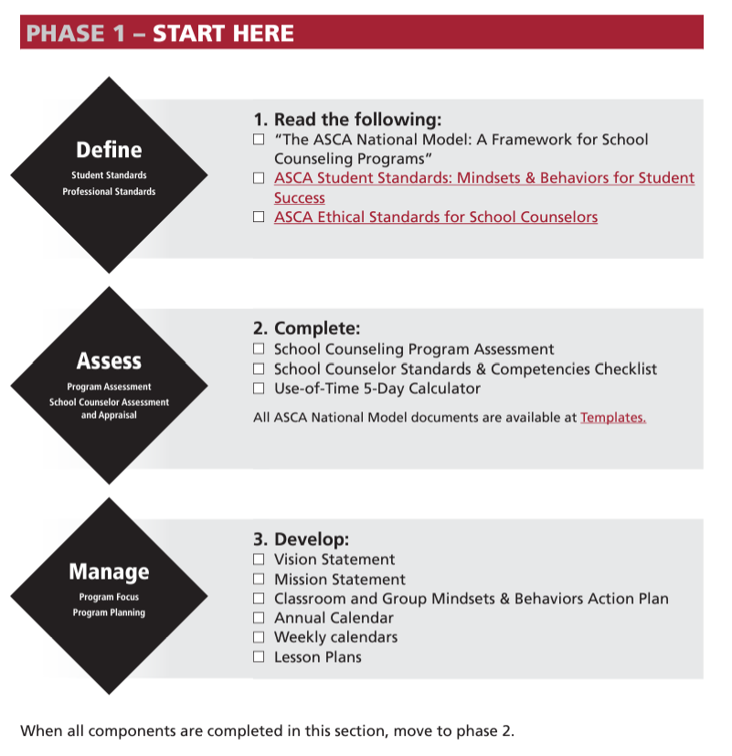
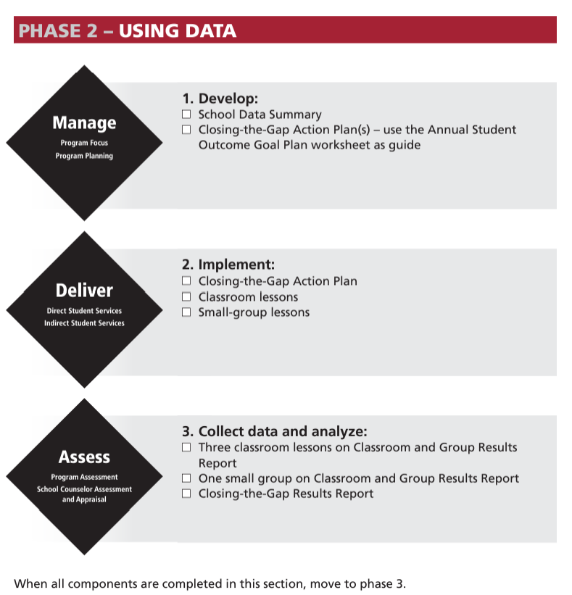
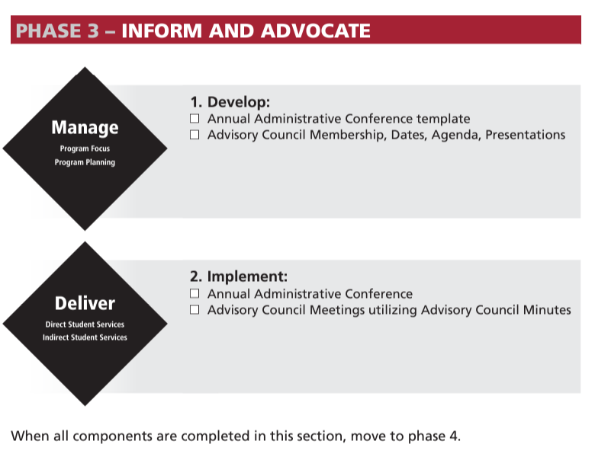
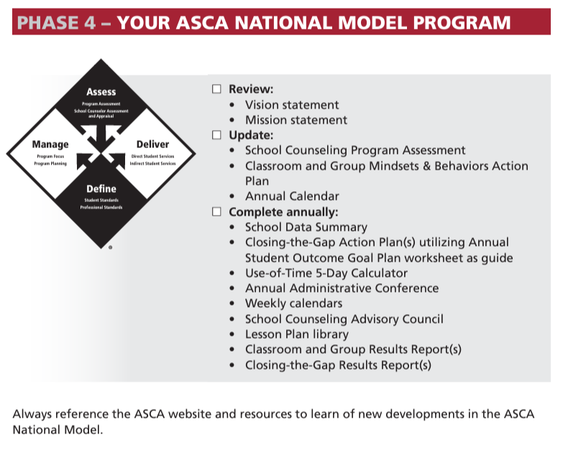
ASCA Model

Slide 11
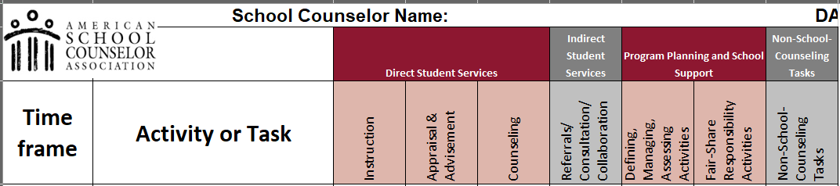
ASCA Model
What’s Next?

Slide 12
Component 1:
Alignment with State and National Standards
The EPS CSCP framework is systematically aligned with state and national learning standards supporting the three domains school counselors are trained to address:
  Social/Emotional Development
  Academic Development
  Career Readiness
Foundational standards for school counseling programming:
  American School Counselor Association Student Standards: Mindsets and Behaviors for Student Success
  Washington’s K-12 Social-Emotional Learning Standards and Benchmarks

Slide 13
Component 2:
Process for Identifying Student Need
The process for identifying student needs aligns with the Multi-Tiered System of Supports framework and includes the following:
  Collecting, disaggregating, and analyzing student-level data
  Monitoring counselor use-of-time data to ensure counselor time is allocated for direct and indirect services
  Engaging in two-way communication with administrators, parents, students, and stakeholders to monitor student growth and communicate outcomes and results

Slide 14
Component 3:
Direct / Indirect Service Delivery
School counselors deliver developmentally appropriate activities and services directly to or indirectly for students.
Direct Services
  In-person interactions between school counselors and students.
  Examples: instruction, advisement, and counseling
Indirect Services
  Services provided on behalf of students.
  Examples: consultation, collaboration, referrals

Slide 15
  Direct Services are in-person interactions between CSCP staff and students that help students improve achievement, attendance, and discipline (for example: instruction, appraisal, advisement, and counseling)
  Indirect Services are provided on behalf of students to enhance student achievement and promote equity and access for all students (for example: collaboration, consultation, student advocacy, and referral)

Slide 16
Component 4:
Annual Review and Assessment
CSCPs are reviewed and assessed annually to improve and enhance program delivery.
  Review and assessment resources available in the ASCA National Model.
  Results are used to update the CSCP annually.
  School counselors can recommend changes to the CSCP based on areas of strength and improvement.
  Results data are reported to school, district, and/or other stakeholders.
Data sources for annual review and assessment may include behavior/discipline, attendance, graduation rates, and/or other sources pertinent to the CSCP.

Slide 17
CSCP Framework Transition Plan
Professional Learning
  Two-year District ASCA National Model Training
  Six full-day sessions during the 2022-2023 and 2023-2024 school years
  Training topics align with and will support the components of the CSCP framework
Collaboration
  The District will regularly schedule and secure locations for counselor Professional Learning Communities and collaboration opportunities.
  Collaboration time will be structured and facilitated by school counselors.
  District will provide collaboration support as requested by school counselors.

Slide 18
ASCA Scope and Sequence
Session Information | Learning Objectives
Session 1, Year 1 | Describe the ASCA National Model Explain three types of data collected in a school counseling program Complete the School Data Summary Create Annual Student Outcome Goal Plan Create a Closing-the-Gap Action Plan Complete Column 1 of the Use-of-Time 5 Day Calculator Navigate ASCA National Model Portal
Session 2, Year 1 | Create Mission and Vision statements Utilize ASCA Student Standards Explain data collection and analysis Calculate and analyze Mindsets & Behaviors pre assessment data Analyze time usage (using Use-of-Time 5 Day Calculator) Draft Annual Calendar
Session 3, Year 1 | Develop Closing-the-Gap Results Reports Finalize Classroom & Group Mindsets & Behaviors Action Plan Identify purpose of Annual Administrative Conference Clarify specific session content for School Counseling Advisory Council meetings

Slide 19
ASCA Scope and Sequence (continued)
Session Information | Learning Objectives
Session 4, Year 2 | Review/refine Classroom & Group MB Action Plan Write Lesson Plans (classroom) Review and refine annual calendar Explain the School Counseling Advisory Council Complete the Annual Administrative Conference template (per counselor)
Session 5, Year 2 | Write Lesson Plans (Small Group) Complete results reports (Classroom, Small Group, Closing-the-Gap) Create a clear and concise graph conveying student impact at a glance Develop end-of-year presentation Identify best practices in reporting program results to stakeholders
Session 6, Year 2 | Advocate for school counseling program using Results Reports Deliver annual school presentation (goals, three classroom lessons, small group, closing- the-gap) Consider RAMP

